Slide 1
Linear Regression and Support Vector Machines
Marcus Rüb
Hahn-Schickard Villingen-Schwenningen
Marcus.rueb@hahn-schickard.de
Notes:
Ob intelligenter Kühlschrank oder Sprachassistent, bereits heute sind in unserem Alltag viele Dinge mit künstlicher Intelligenz ausgestattet. Im Zeitalter des Internet of Things (IoT) und der Industrie 4.0 werden intelligente Systeme immer wichtiger.
Zur Ausführung von vielen neuronalen Netzen wird allerdings nicht immer die Rechenleistung von großen und teuren Rechner benötigt. Stattdessen kann hier auch die Rechenleistung eines eingebetteten Systems, wie die eines Mikrocontrollers, ausreichen.
Allerdings ist die Unterstützung von Plattformen zur Ausführung von neuronalen Netzen, nicht ohne weiteres gegeben ist.
Das Modell muss zuerst manuell konvertiert, eingebunden und ausgeführt werden

Slide 2
This session:
Linear regression
Least square
Gradient decent
SVM

Slide 3

Outline for Supervised Learning (1)
Supervised Learning (1)
Linear, polynomial regression
Lasso, Ridge, ElasticNet regression
Logistic Regression
Support Vector Machines (SVM)
Hands-on Supervised Learning
Predict price of vacation rentals in Frankfurt on Airbnb

Slide 4
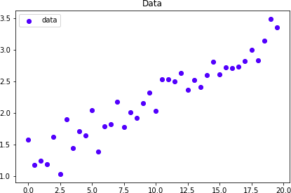
Linear Regression
Let’s create some data
𝑦 = 0.1𝑥 + 1.25 + 0.2𝐺𝑎𝑢𝑠𝑠𝑖𝑎𝑛𝑁𝑜𝑖𝑠𝑒

Slide 5
Fit in a line

Slide 6
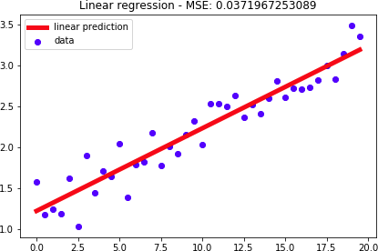
Linear Regression
Let’s perform linear regression…
𝑦 = 0.1𝑥 + 1.25 + 0.2 𝐺𝑎𝑢𝑠𝑠𝑖𝑎𝑛𝑁𝑜𝑖𝑠𝑒
𝑦 = m𝑥 + 𝑏
w = 0.1014
b = 1.2258
𝑦 = 0.1014𝑥 + 1.2258

Slide 7
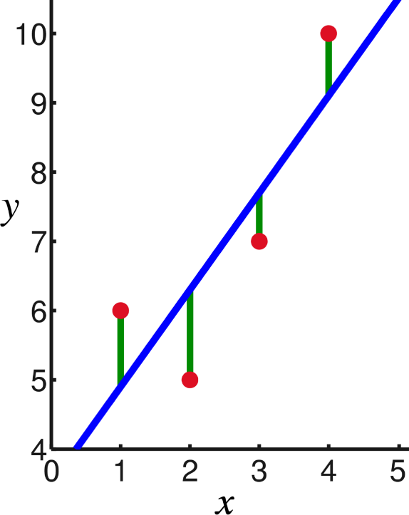
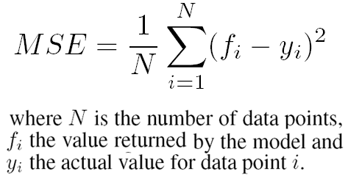
How we fitted the line?
We just found the values of ‘m’ and ‘b’ that minimize the Mean Squared Error
Mean Squared Error

Slide 8
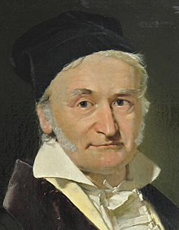
C.F. Gauss
Born: 30. April 1777
† 23. Februar 1855
German mathematician
With 18 he invent the Least square method
Carl Friedrich Gauss

Slide 9
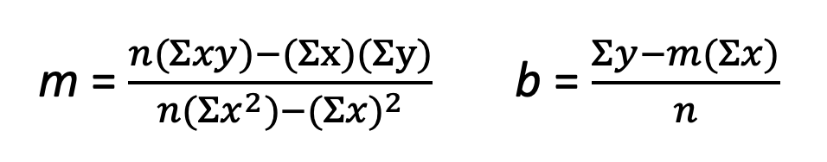
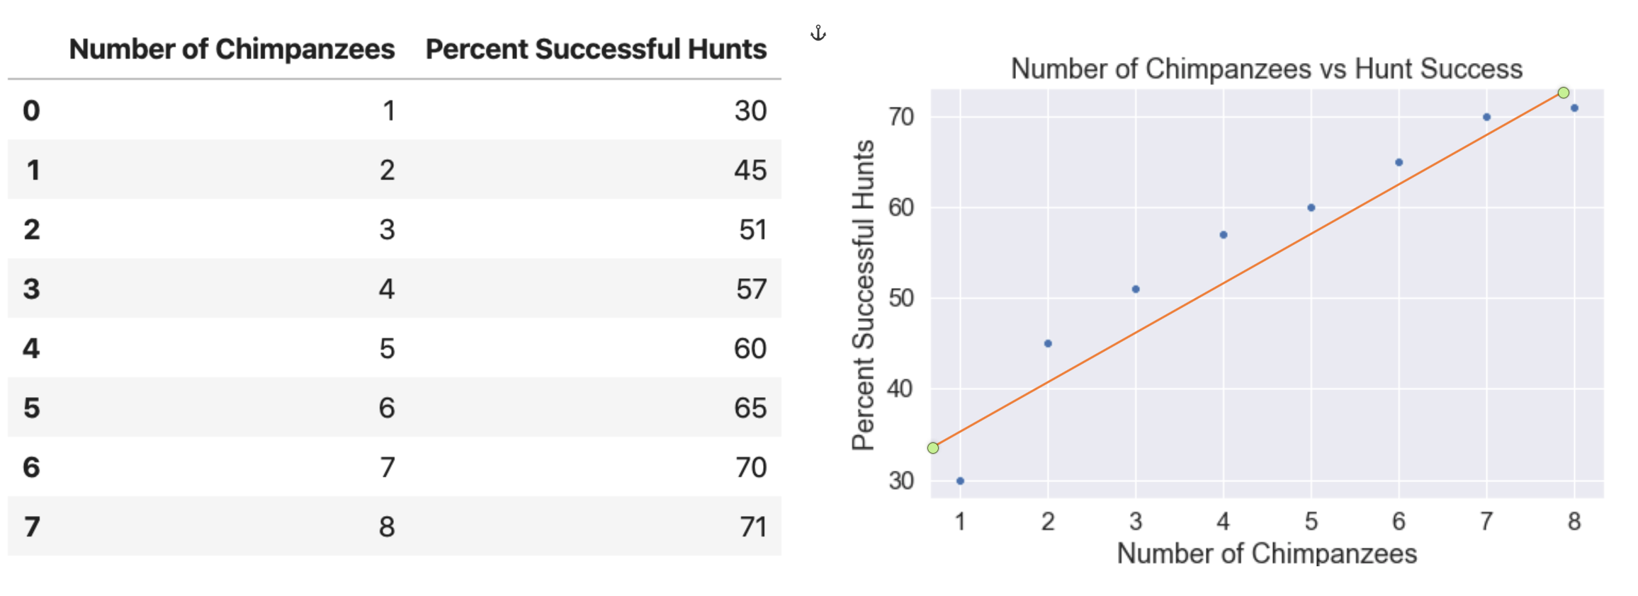
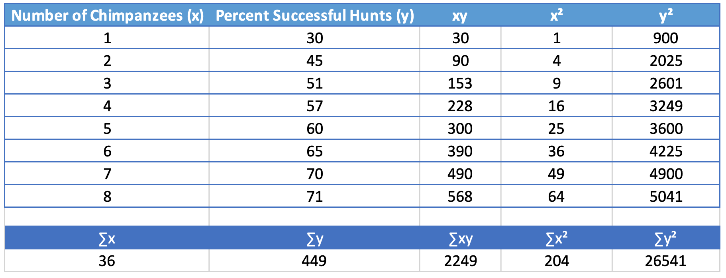
Least Square
𝑦 = m𝑥 + 𝑏
n
x
y

Slide 11
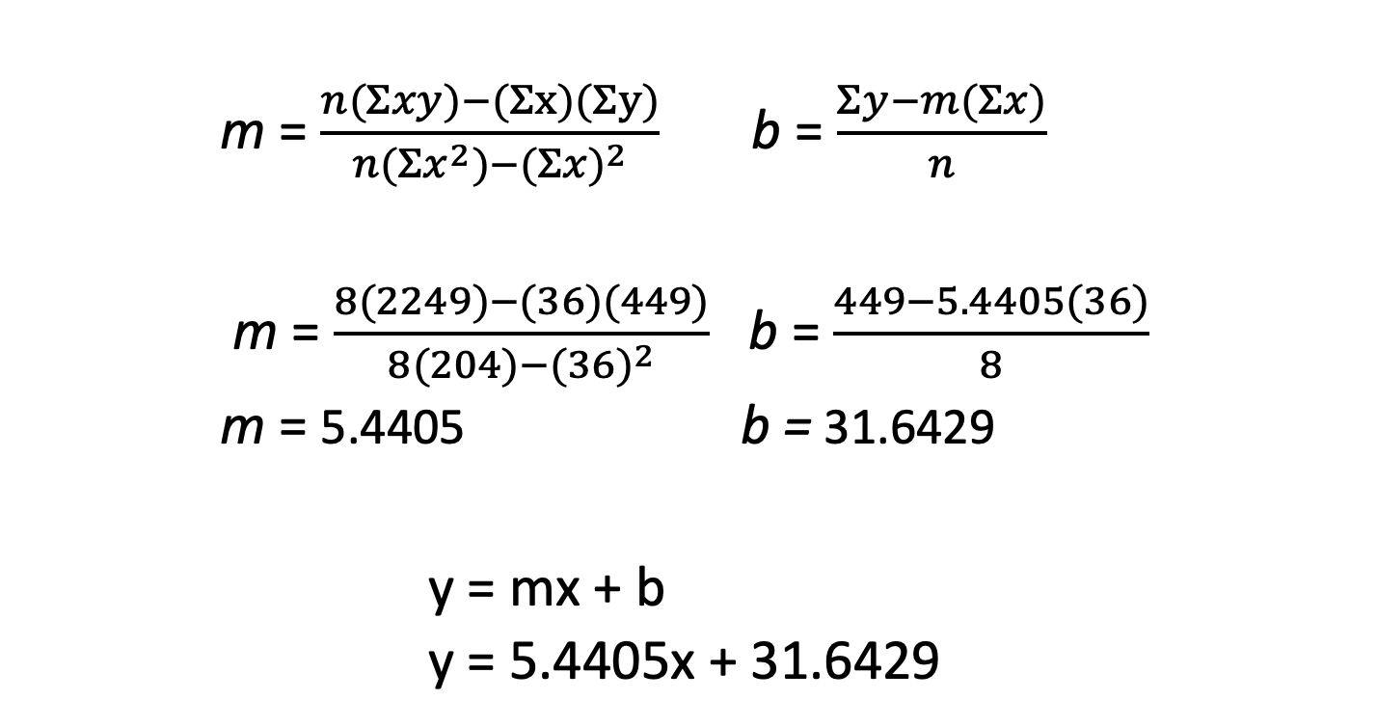

Slide 12
Least Squares - notation
𝑦 = 𝑤𝑥 + 𝑏 = 𝑏 + 𝑤𝑥
Also called features
𝑋 = 1, 𝑥
𝑊 = 𝑏, 𝑤
𝑦 = 𝑊𝑋 = 𝑏 + 𝑤𝑥
𝑋
=
𝑥₀ = 1
𝑤₀ = 𝑏
𝑥₀, 𝑥₁, 𝑥₂, 𝑥₃, … , 𝑥_{𝑛}
𝑊 = 𝑤₀, 𝑤₁, 𝑤₂, 𝑤₃, … , 𝑤_{𝑛}
𝑦 = 𝑊𝑋 = 𝑤₀𝑥₀ + 𝑤₁𝑥₁ + 𝑤₂𝑥₂ + ⋯ + 𝑤_{𝑛}𝑥_{𝑛}
𝑥₀ | 𝑥_{𝟏} | 𝒚
1 | 0.0 | 1.57
1 | 0.5 | 1.18
1 | 1.0 | 1.24
1 | 1.5 | 1.19
1 | 2.0 | 1.62
X = matrix (m,n) Y = vector (m)
m = number of samples n = number of features

Slide 13
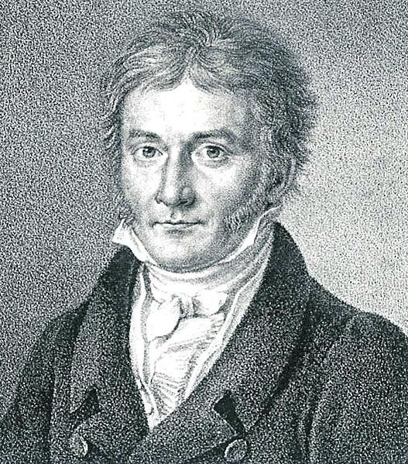

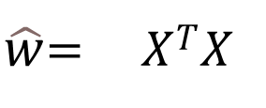
How we fitted the line?
Which values of line parameters minimize the Mean Squared Error?
Least squares Method Least Squares Method
$\hat{w}$= 𝑋^{𝑇}𝑋
−1_{𝑋}𝑇_{𝑦}
𝑋 = 𝑥₀, 𝑥₁, 𝑥₂, 𝑥₃, … , 𝑥_{𝑛}
𝑊 = 𝑤₀, 𝑤₁, 𝑤₂, 𝑤₃, … , 𝑤_{𝑛}
𝑥₀ = 1
𝑤₀ = 𝑏
𝑦 = 𝑊𝑋 = 𝑤₀𝑥₀ + 𝑤₁𝑥₁ + 𝑤₂𝑥₂ + ⋯ + 𝑤_{𝑛}𝑥_{𝑛}
$$\hat{w}$$
is the best approximation to W
Carl Friedrich Gauss

Slide 14

How we fitted the line?
Which values of line parameters minimize the Mean Squared Error?
Least squares Method Least Squares Method
$\hat{w}$= 𝑋^{𝑇}𝑋
−1_{𝑋}𝑇_{𝑦}
Carl Friedrich Gauss

Slide 15
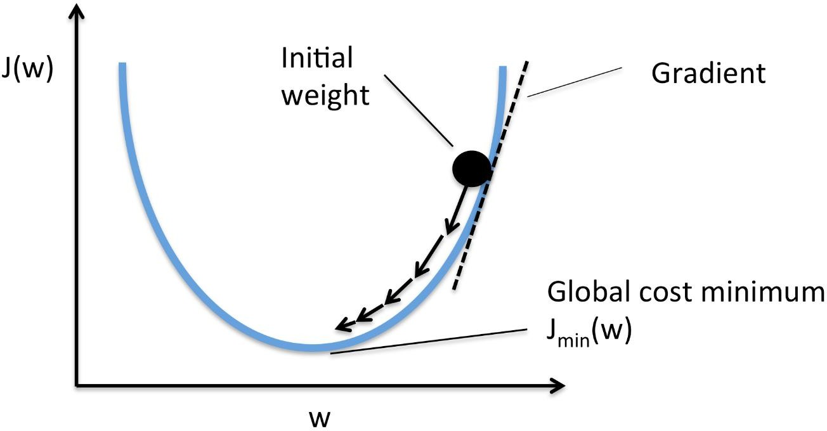
Gradient Descent
There is another way: Gradient Descent
Mean Squared Error
Learning
𝜕𝐽
𝑊 = 𝑊 − 𝛼 _{𝜕𝑊}
Gradient Descent Visualization. Credit: rasbt.github.io

Slide 16

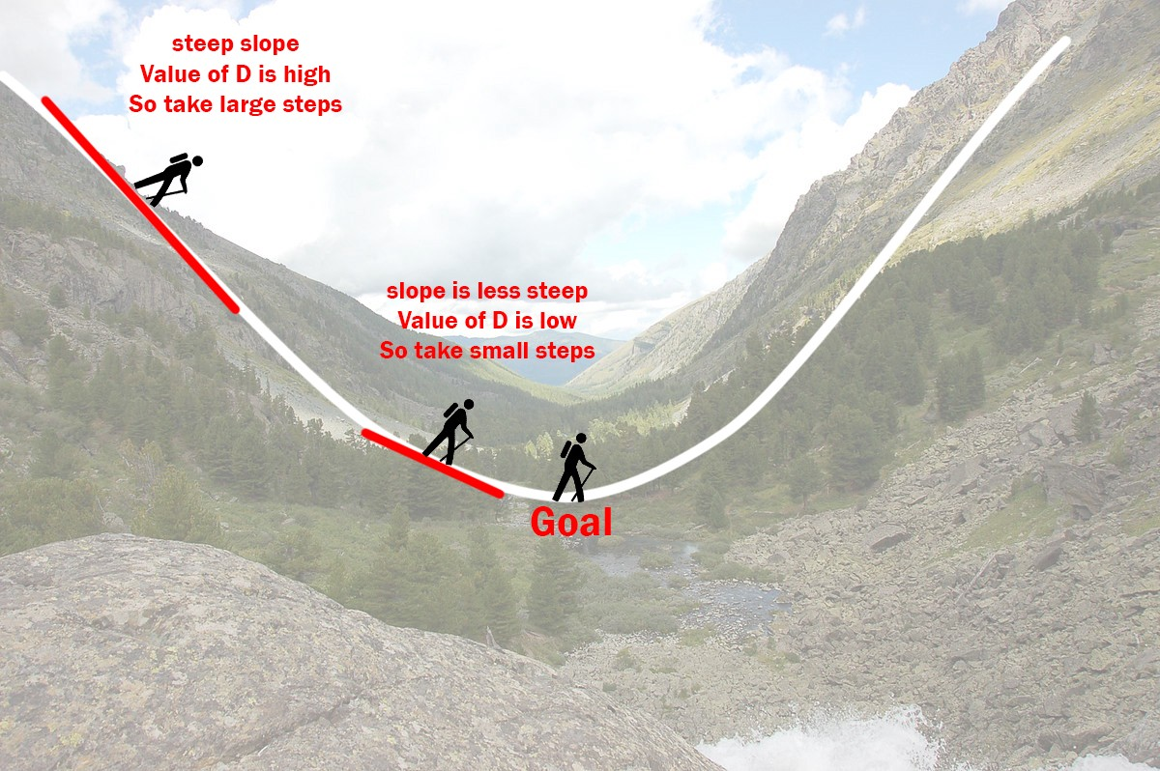
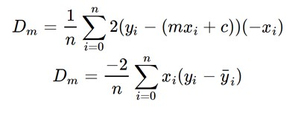


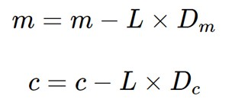
Gradient Descent
Derivation:
𝑦 = m𝑥 + b

Slide 17


$\hat{w}$= 𝑋^{𝑇}𝑋
−1_{𝑋}𝑇_{𝑦}
Least Squares
when there is a relatively small number of features (< 1,000)
Gradient Descent
when there are many features (> 1,000)
when we need to stop training at any time
e.g. if we only have 1 minute
If data does not fit in memory
If you have new data (e.g. stream) and don’t want to start all over (with all previous data)

Slide 18
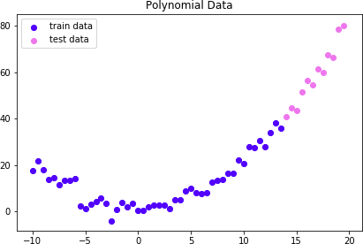
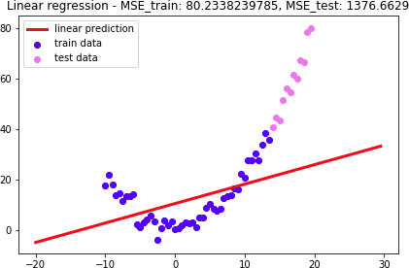
Polynomial Regression
𝑦 = 0.2𝒙^{𝟐} + 0.1𝑥 + 1 + 3𝐺𝑎𝑢𝑠𝑠𝑖𝑎𝑛𝑁𝑜𝑖𝑠𝑒
Linear Regression: y = w₀ + w₁x

Slide 19
Polynomial Regression
You already know how to do it
It is not a new technique, it’s a feature
x
x |  | _{x}2
𝑥₀ | 𝑥_{𝟏} | 𝑥_{𝟐} | 𝒚
1 | -10.0 | 100.0 | 17.74
1 | -9.5 | 90.25 | 21.86
1 | -9 | 81.00 | 17.84
1 | -8.5 | 72.25 | 13.71
1 | -8 | 64.00 | 14.47
𝑥₀ | 𝑥_{𝟏} | 𝒚
1 | -10.0 | 17.74
1 | -9.5 | 21.86
1 | -9 | 17.84
1 | -8.5 | 13.71
1 | -8 | 14.47

Slide 20
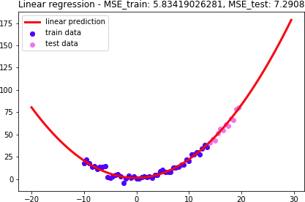
Polynomial Regression
𝑦 = 0.2𝒙^{𝟐} + 0.1𝑥 + 1 + 3𝐺𝑎𝑢𝑠𝑠𝑖𝑎𝑛𝑁𝑜𝑖𝑠𝑒
Linear Regression: y = w₀ + w₁x + w₂x²

Slide 21
Polynomial Regression
Polynomial Regression = Linear Regression with polynomial features
You can get creative:
x², x³, x⁴…
zx², zx³, z²x², …
x |  |  | _{x}2
Features | 𝑥₀ | 𝑥_{𝟏} | 𝑥_{𝟐} | 𝒚
 | 1 | -10.0 | 100.0 | 17.74
 | 1 | -9.5 | 90.25 | 21.86
 | 1 | -9 | 81.00 | 17.84
 | 1 | -8.5 | 72.25 | 13.71
 | 1 | -8 | 64.00 | 14.47

Slide 22

What if some of the inputs are irrelevant?
Ridge Regression
Lasso Regression
ElasticNet Regression

Slide 23
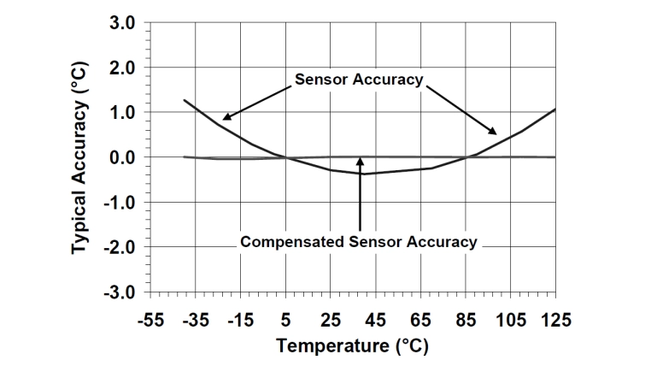
Where is this used?
C02 Sensor
Error with different temperatures, humidity and pressure
C02 = Sensor*x0+temp*x1+hum*x2+pres*x3

Slide 24
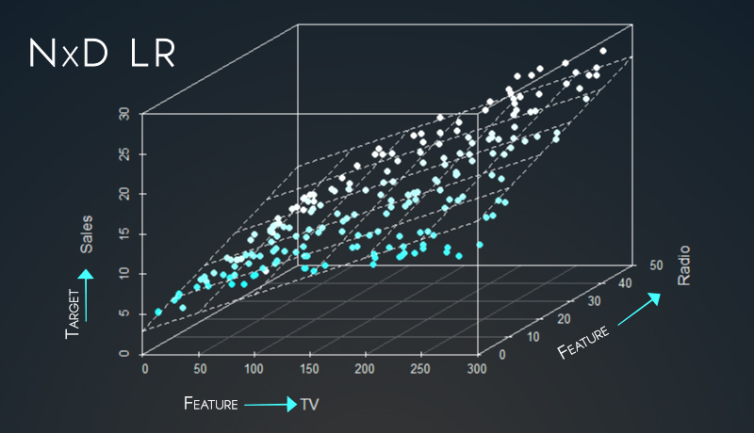
Car price Calculator
What for features do we have?

Slide 25
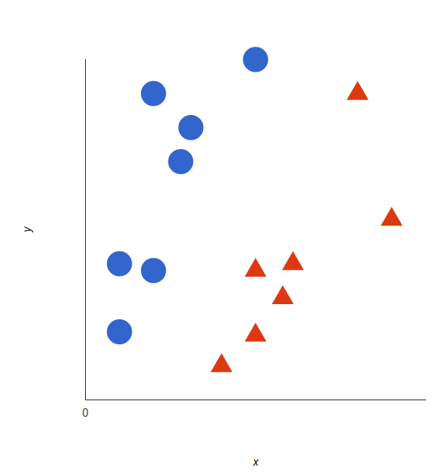
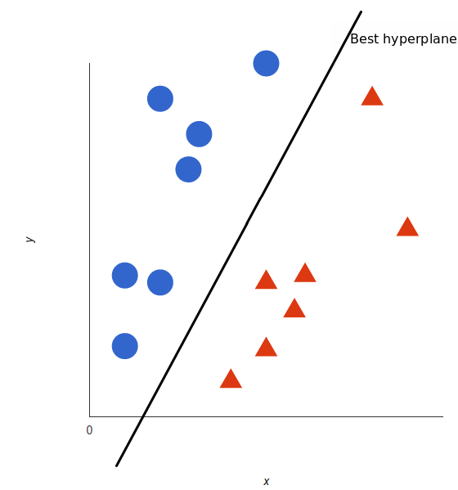
Support Vector Machines

Slide 26
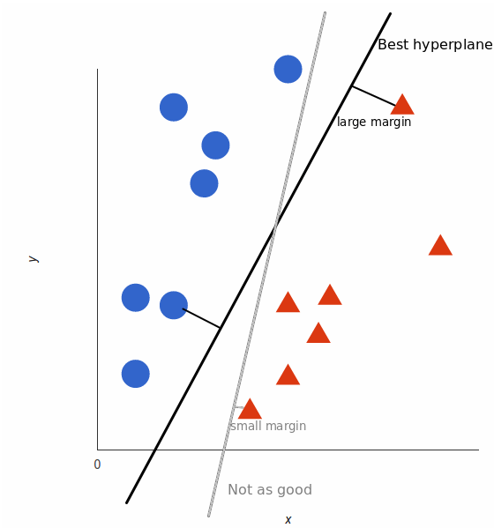
But, what exactly is the best hyperplane?

Slide 27
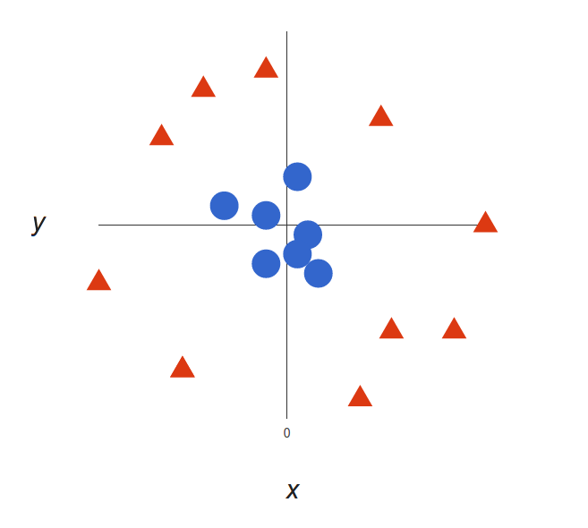
Nonlinear data
Notes:
https://youtu.be/3liCbRZPrZA

Slide 28
Questions
What is linear regression?
What is it used for?
How do we get the linear model? Name 2 Methods. And when do you use them.
Explain the steps of the gradient decent.
What is SVM used for?
Which features do we have for example in a House Price calculator with linear regression?
What is the kernel trick?
Calculate a linear regression model for this Datapoints
N | X | Y
0 | 1 | 2
1 | 2 | 3
2 | 3 | 7
3 | 4 | 8

Slide 29
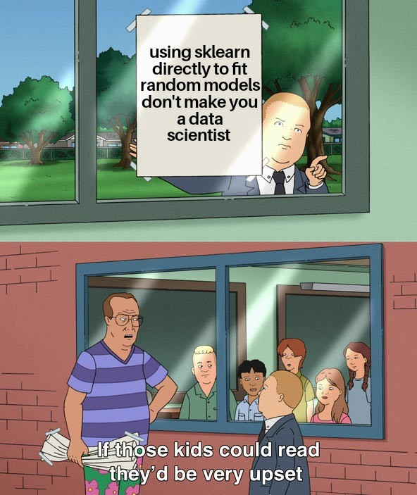
Outlook

